Slide 1

NBA Shots Analysis
Michael Armesto, David Doman, N’Dea Jackson, Matthew McDonnell

Slide 2
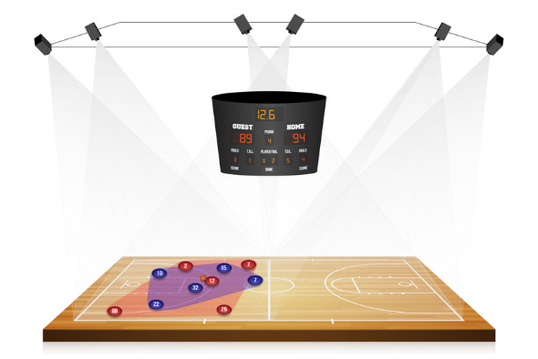
Brief Background
Sourced from Kaggle
122,106 rows & 30 columns
Situational variables (dribbles, distance from hoop) and scenario variables (opponent, venue location)
Some data cleaning was performed such as changing variable types and discretizing certain variables
Some random sampling was used to perform more efficient SVM analysis

Slide 3
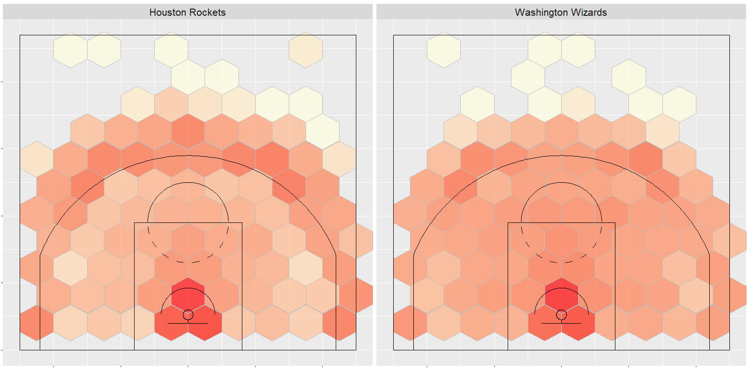
Clustering– Player Types
Clustered players by offensive style based on shot selection
Shots broken into 5 zones:
Above the Break 3
Corner 3
Midrange
Restricted Area
In the Paint (non-RA)
Variables used:
Attempt percentage in each zone
Relative accuracy in each zone

Slide 4
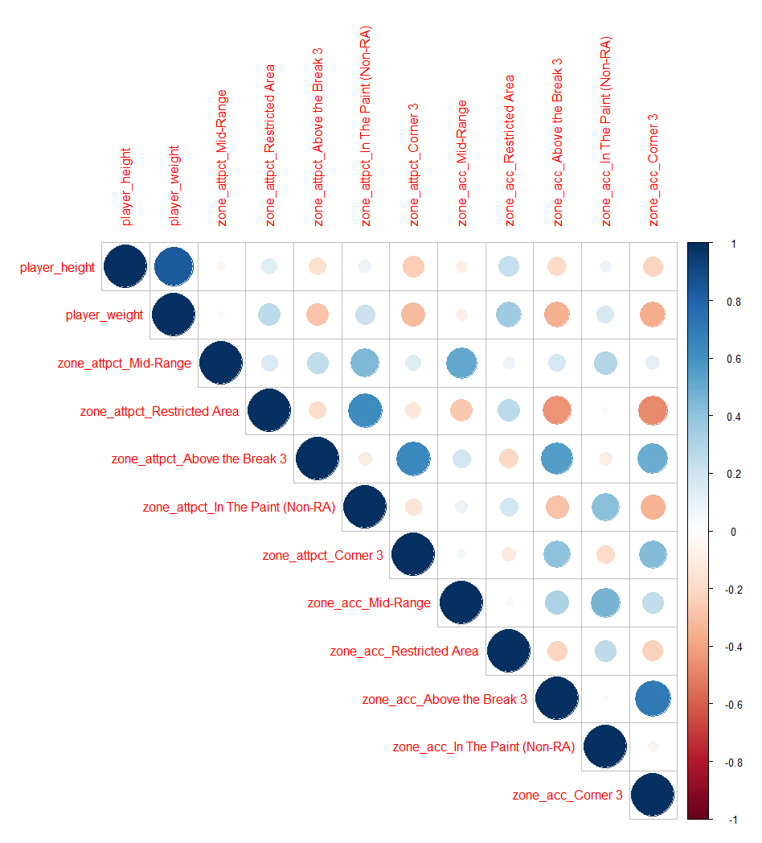
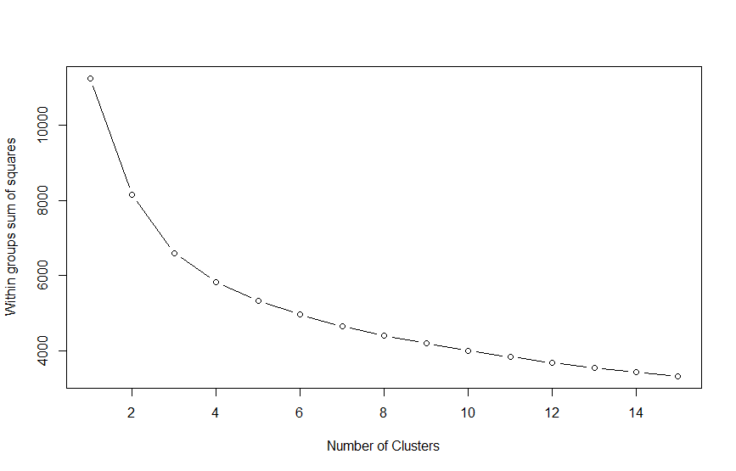
Clustering
Principal Component Analysis was used due to high correlation in variables
Most impactful variables on PCA were shot attempt percentages by zone, particularly corner and above-break three-pointers

Slide 5
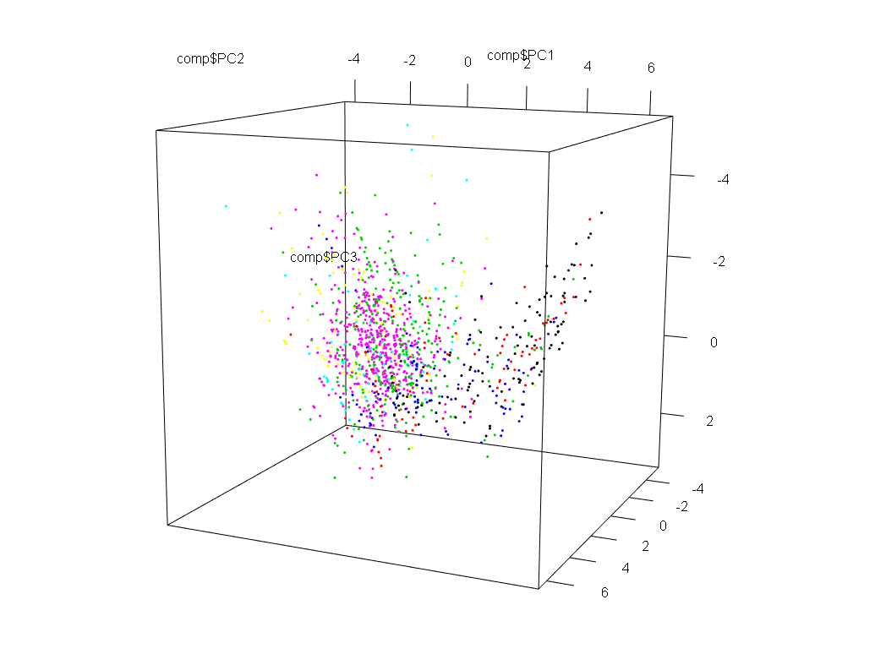
Cluster by Position

Slide 6
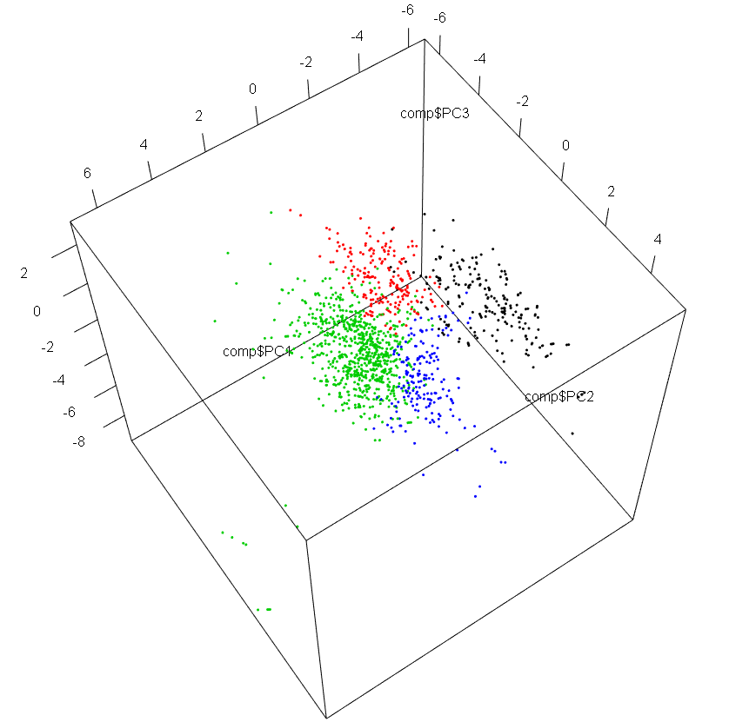
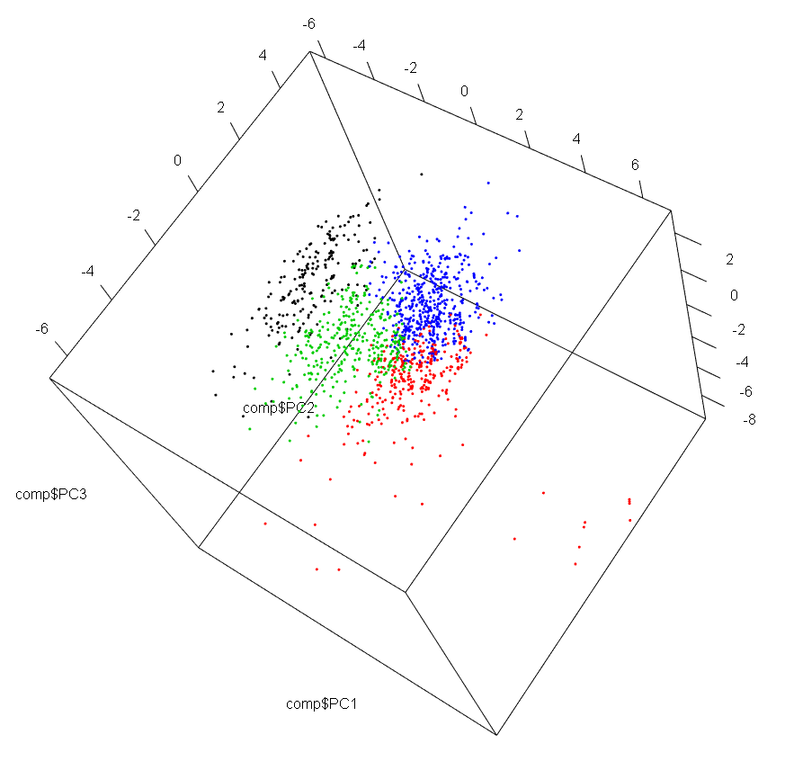
HAC Clustering Euclidean Distancing
K-Means Clustering

Slide 7
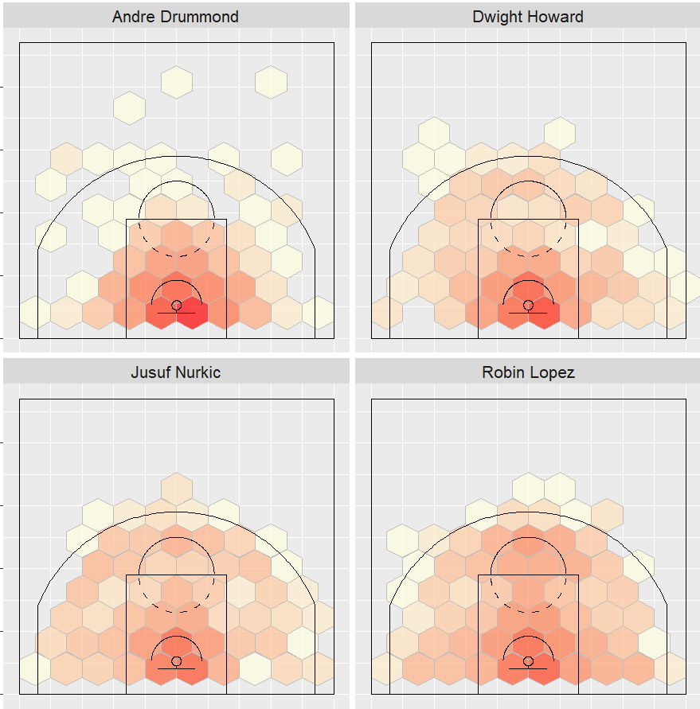
Player Type One

Slide 8
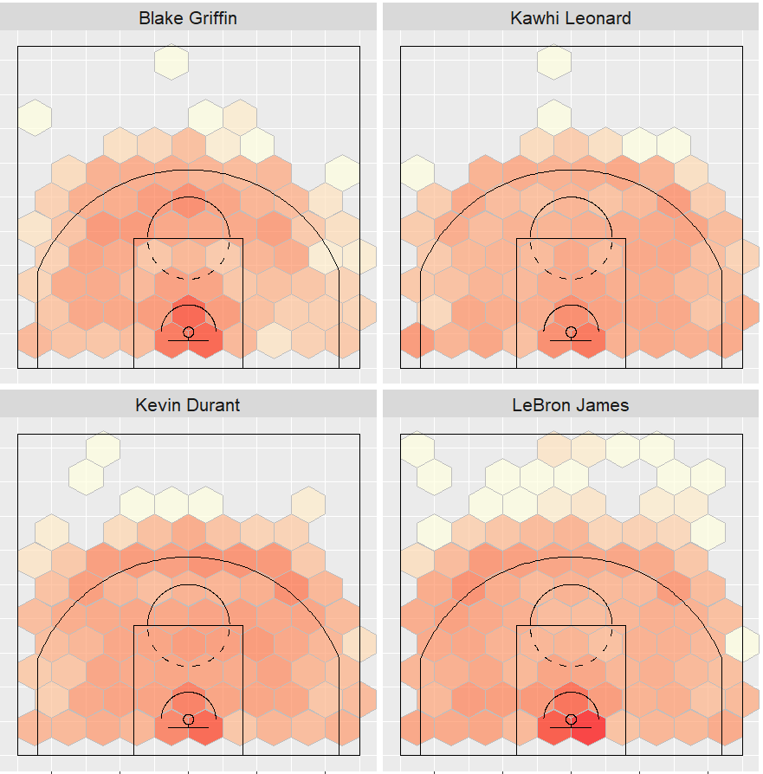
Player Type Two

Slide 9
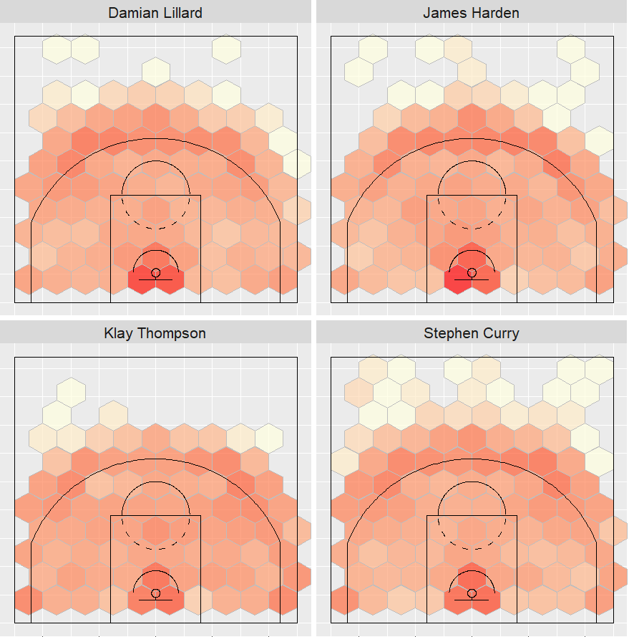
Player Type Three

Slide 10
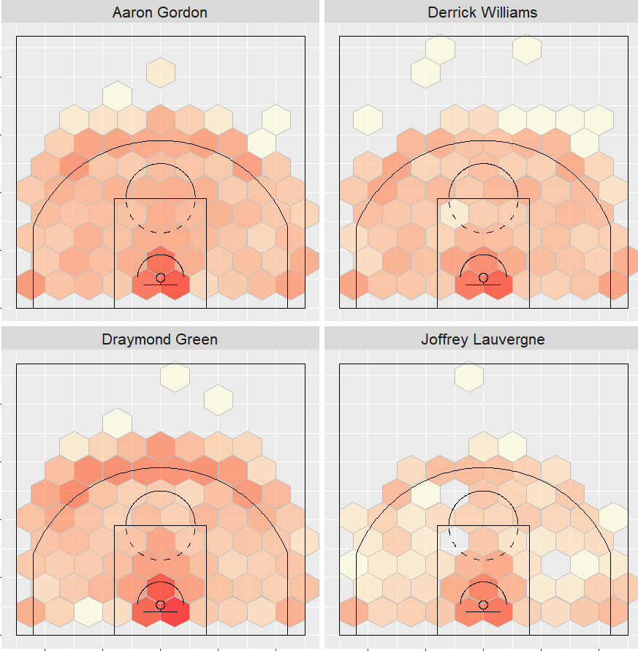
Player Type Four

Slide 11
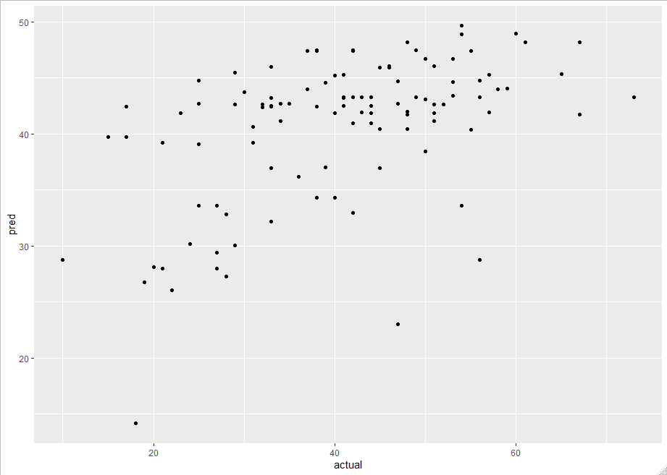
Evaluation of Clustering Model
Of 187 players with >= 3 seasons of data 84% were clustered as same type each year
Number of each player type per roster correlated with season wins in linear model
HAC Clustering
RMSE: 11.3

Slide 12
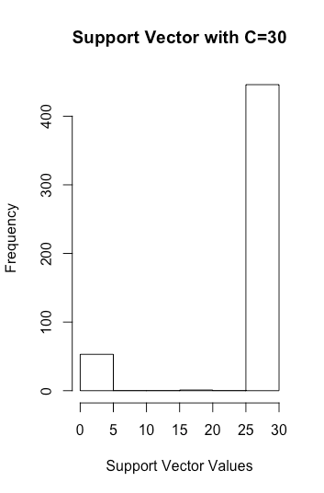
Support Vector Machine Analysis
Predicting a win or loss depending on home/away location status and opponent:
- Right-side shows difficulty in the model's predictive zoning
- Left-side shows points that are too easy to predict so offer no help to the modeling power
- Important to utilize the cost coefficient (C) to find a compromise that works for the model

Slide 13
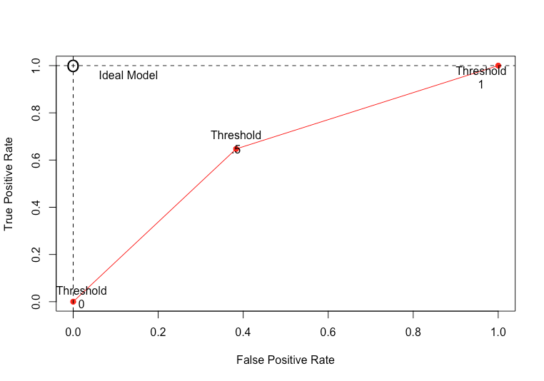
Confusion Matrix and Statistics
Prediction L W
L 77 69
W 42 111
Accuracy: 62.9%
No Information Rate: 60.2%
Balanced Accuracy: 63.2%

Slide 14
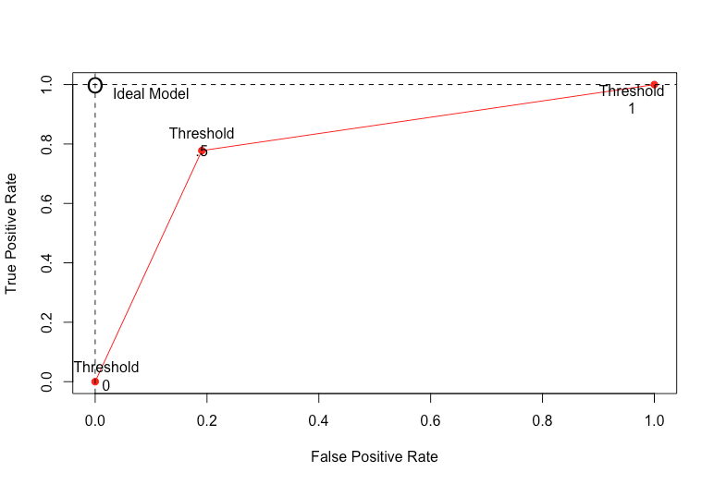
Support Vector Machine Analysis
Predicting a successful shot attempt depending on situational variables:
Prediction made missed
made 103 28
missed 34 134
Accuracy: 79.3%
No Information Rate: 54.2%
Balanced Accuracy: 79.0%
P-Value: 2e-16

Slide 15
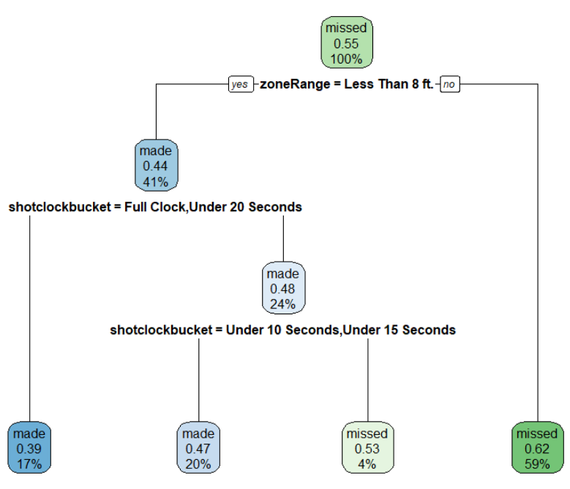
Decision Tree – Shot Result
Variable Importance:
ZoneRange
SHOT_DISTkbucket
shotclockbucket
Confusion Matrix
made missed Sum
made 6,334 4,876 11,210
missed 7,478 11,838 19,316
Sum 13,812 16,714 30,526
Prediction Accuracy: 59.53%

Slide 16
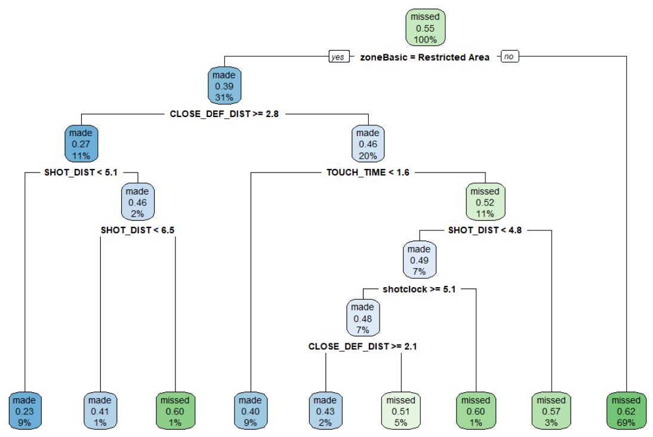
Decision Tree – Shot Result
Variable Importance:
ZoneBASIC
SHOT_DIST
ZoneRange
CLOSE_DEF_DIST
Shotclock
TOUCH_TIME
Dribbles
Confusion Matrix
made missed Sum
made 4,535 2,207 6,742
missed 9,277 14,507 23,784
Sum 13,812 16,714 30,526
Prediction Accuracy: 62.38%

Slide 17
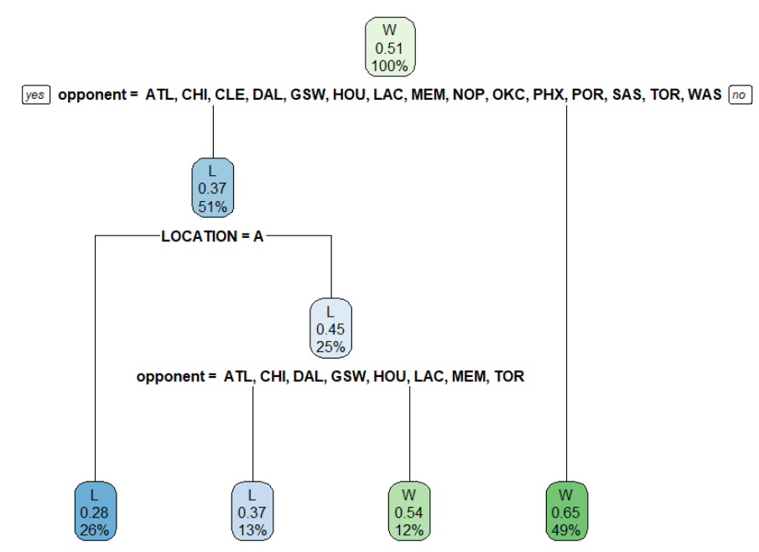
Decision Tree – Win/Loss
Variable Importance:
Opponent
Location
Confusion Matrix
L W Sum
L 8,102 3,734 11,836
W 7,093 11,597 18,690
Sum 15,195 15,331 30,526
Prediction Accuracy: 64.54%

Slide 18
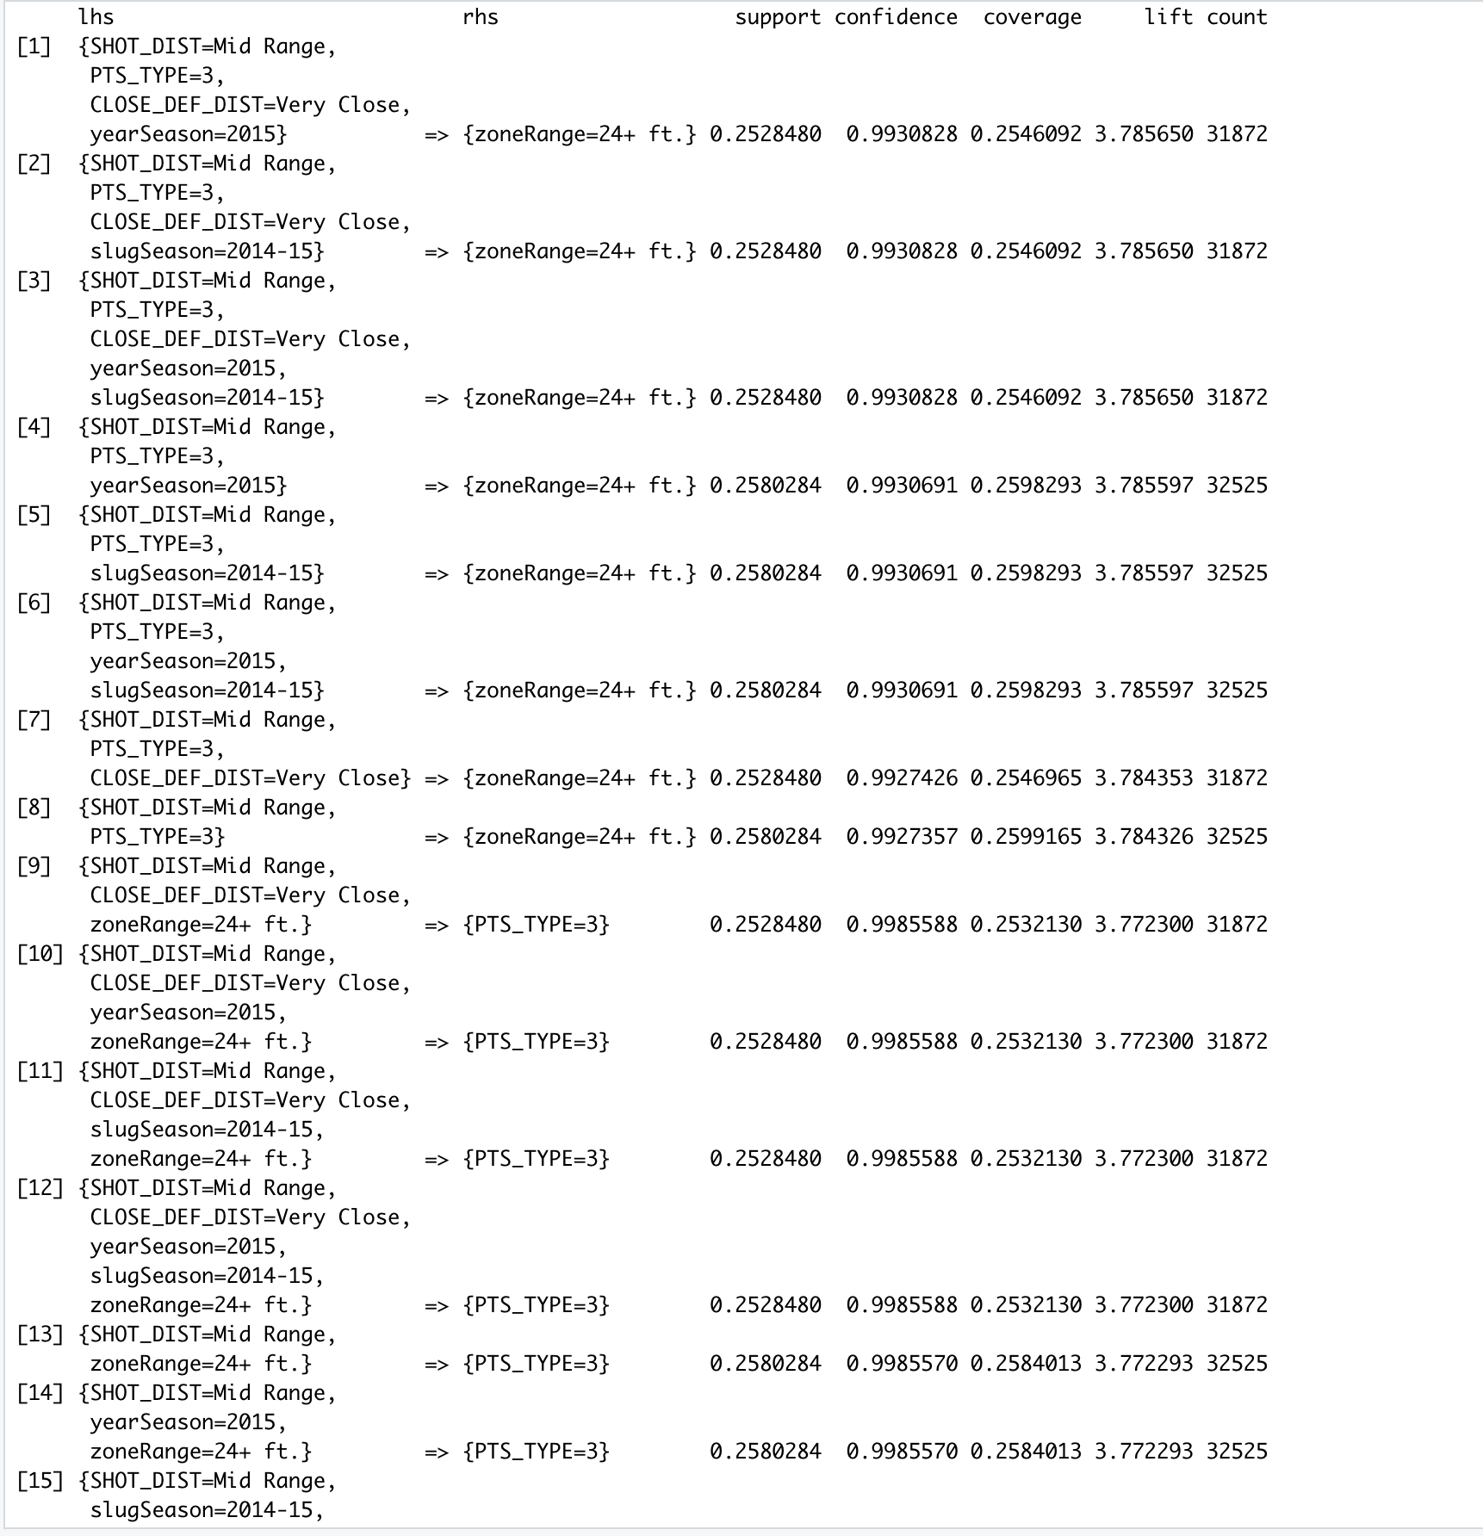
Association Rule Mining
- Unspecified "RHS"
- Irrelevant columns included
- Didn't give us any useful information about our data

Slide 19
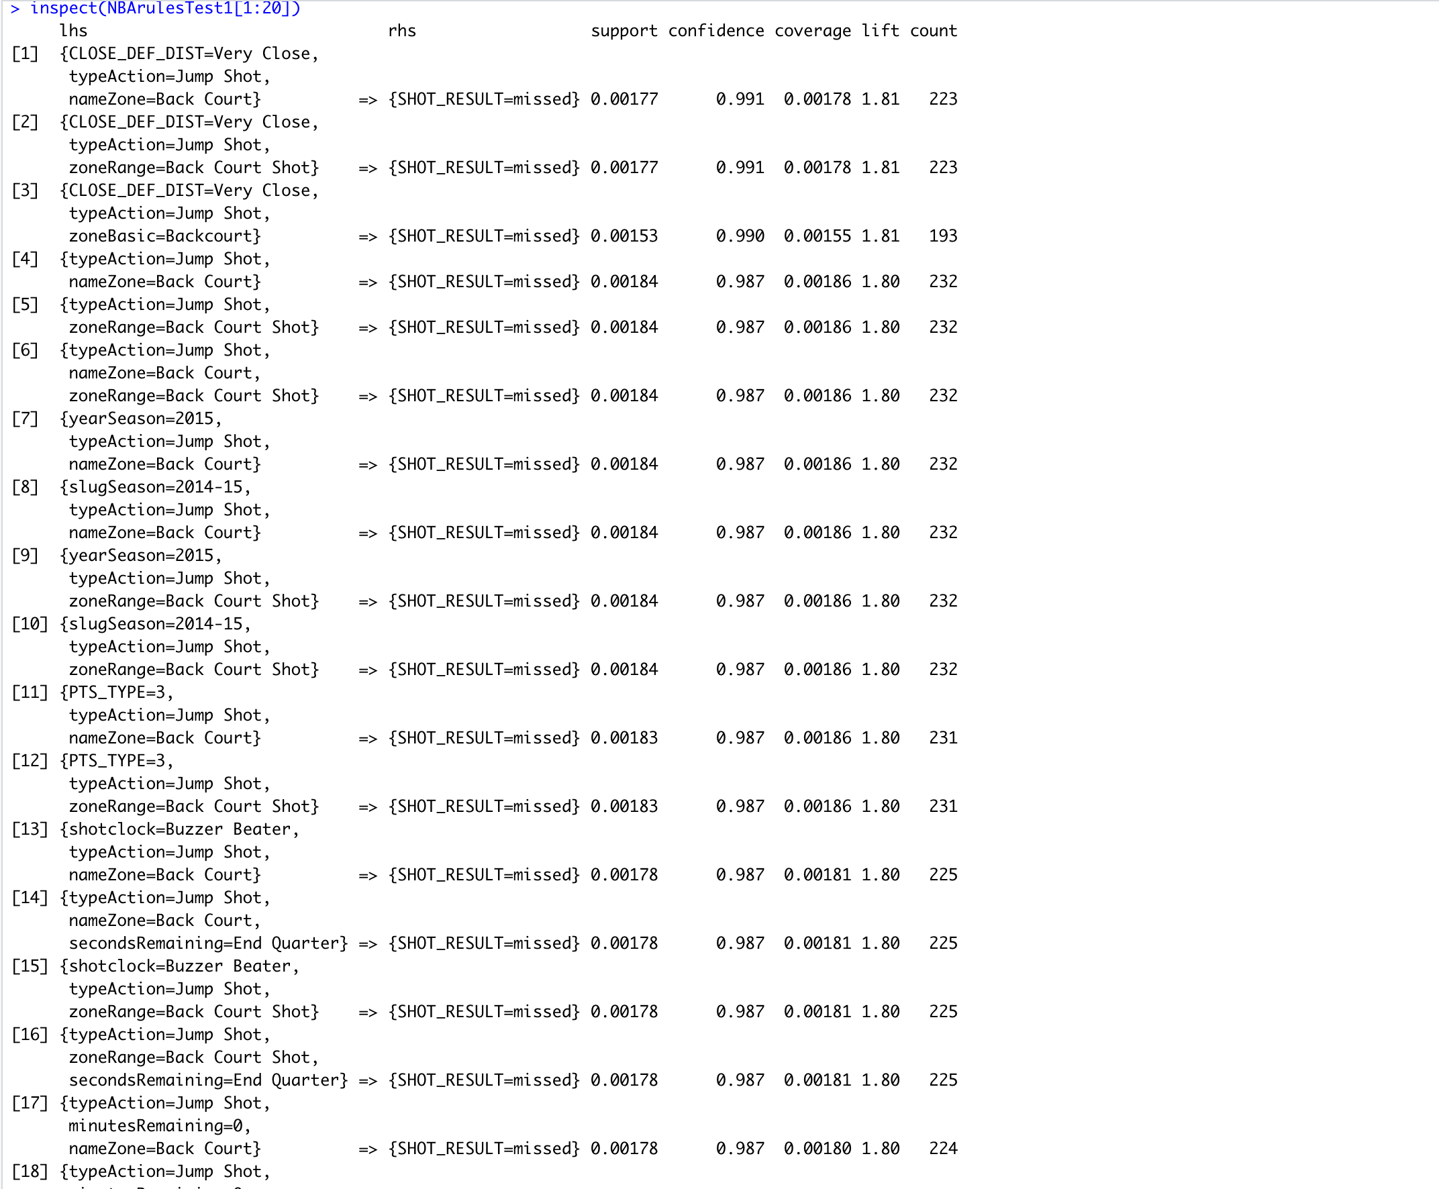
Association Rule Mining – Missed Shots (RHS)
Created a "test" dataset and removed columns:
- FGM
- PTS
- typeEvent
- isShotAttempted
- isShotMade
Specified "SHOT_Result = missed" as the rhs of the apriori

Slide 20
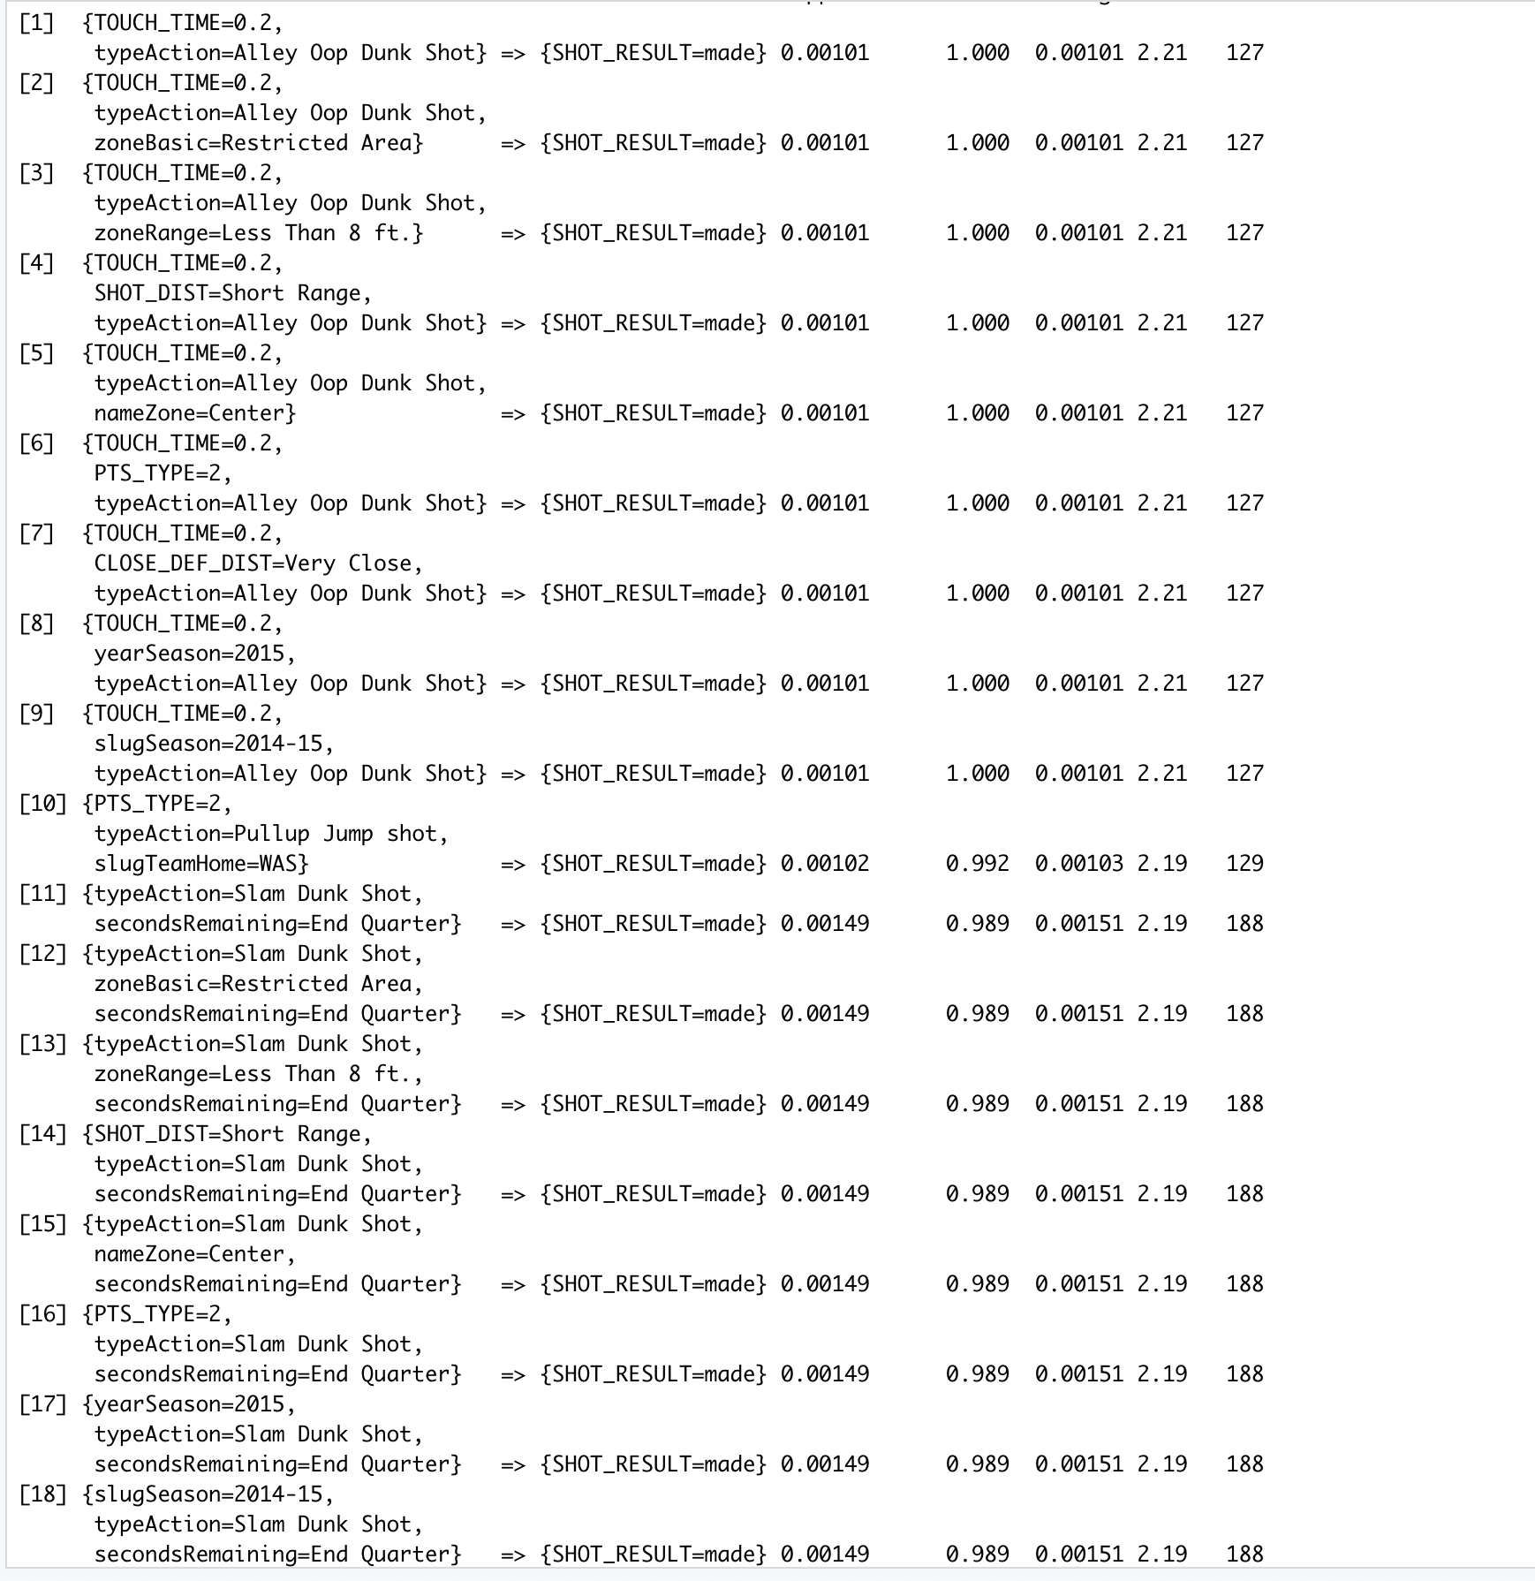
Association Rule Mining – Made Shots (RHS)
Created a "test" dataset and removed columns:
- FGM
- PTS
- typeEvent
- isShotAttempted
- isShotMade
Specified "SHOT_Result = made" as the rhs of the apriori

Slide 21
Conclusions
We found that the SVM analysis was the most effective in predicting whether a shot will be made or not.
Decision Trees were the most effective in predicting a win vs. a loss, although the SVM was just slightly lower in predicting accuracy.
There may be other attributes that could be valuable to this analysis, such as, a team's record during a particular game, injuries that could affect a team's game plan, travel time for the away team, etc.

